Slide 1

Data Analysis & Visualization
Abhilash Basuru Yethesh Kumar
Abhinaya Krishnamachari
Annapoorna Chandrashekar Kadur
Darshan Dalvi
Frida Lin (Rong-Chian)
Gokulramanan Soundararajan
Harjeet Singhs Jaggi
Pradnya Prabhudesai
Supriya Nanjundaswamy
HW1: Supermarket Transaction Business Intelligence and Big Data analysis

Slide 2
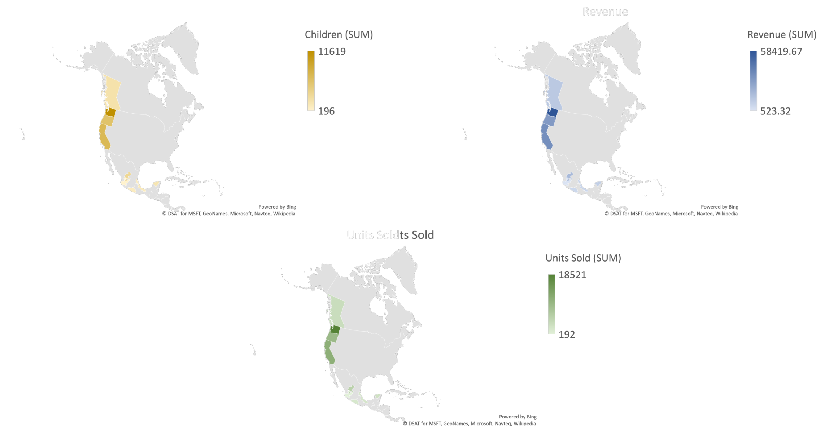
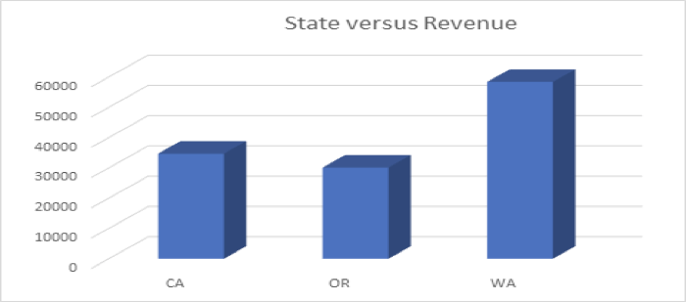
Most Profitable State?
 | CA | OR | WA
Number of cities with stores | 4 | 2 | 7
Distinct customers | 1651 | 879 | 1392
Total Revenue | 34,730.41 | 30,138.44 | 58,419.67
Rev. generated per customers | 21.04 | 34.29 | 41.97

Slide 3
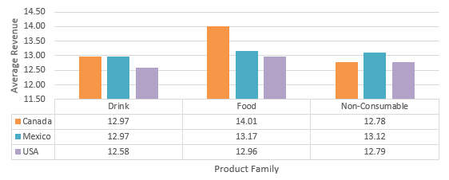
Rev. per Transaction in Countries
Notes:
$30-$50k annual income category gives the highest revenue

Slide 4
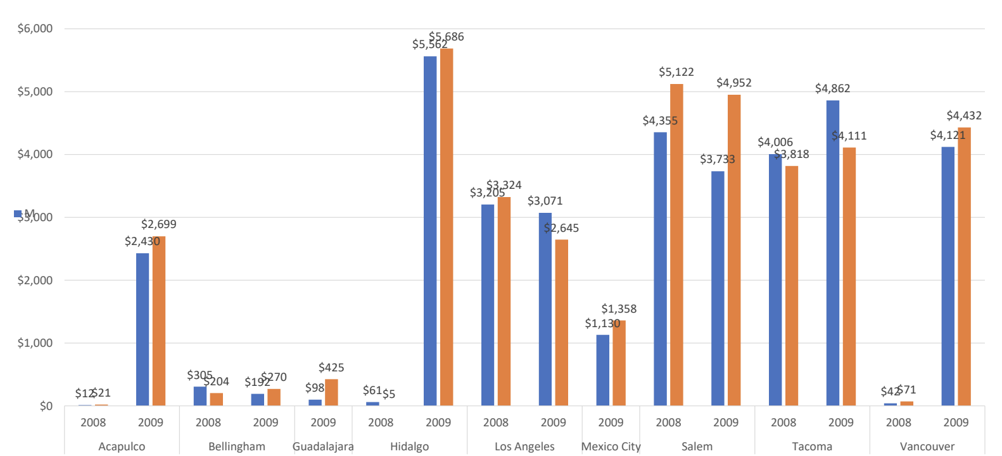
Trends Observed in Cities
married: blue/ single: orange

Slide 5
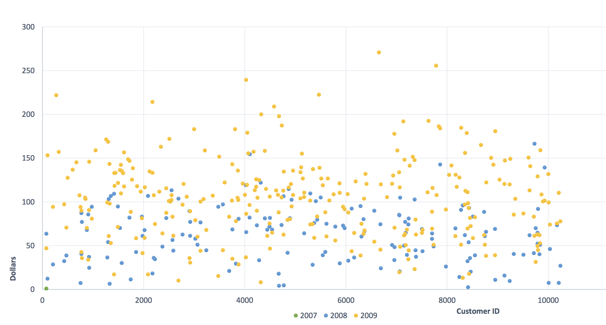
Premium Customers

Slide 6
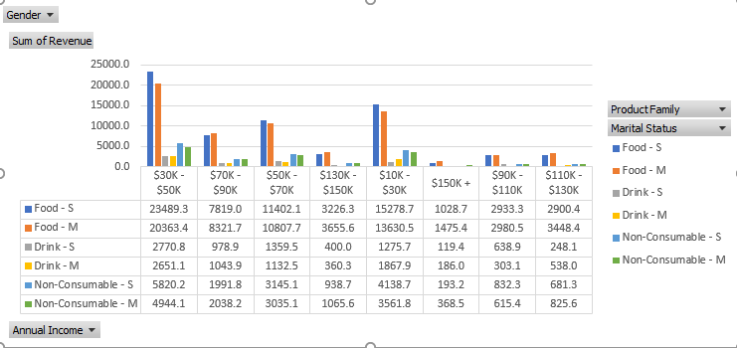
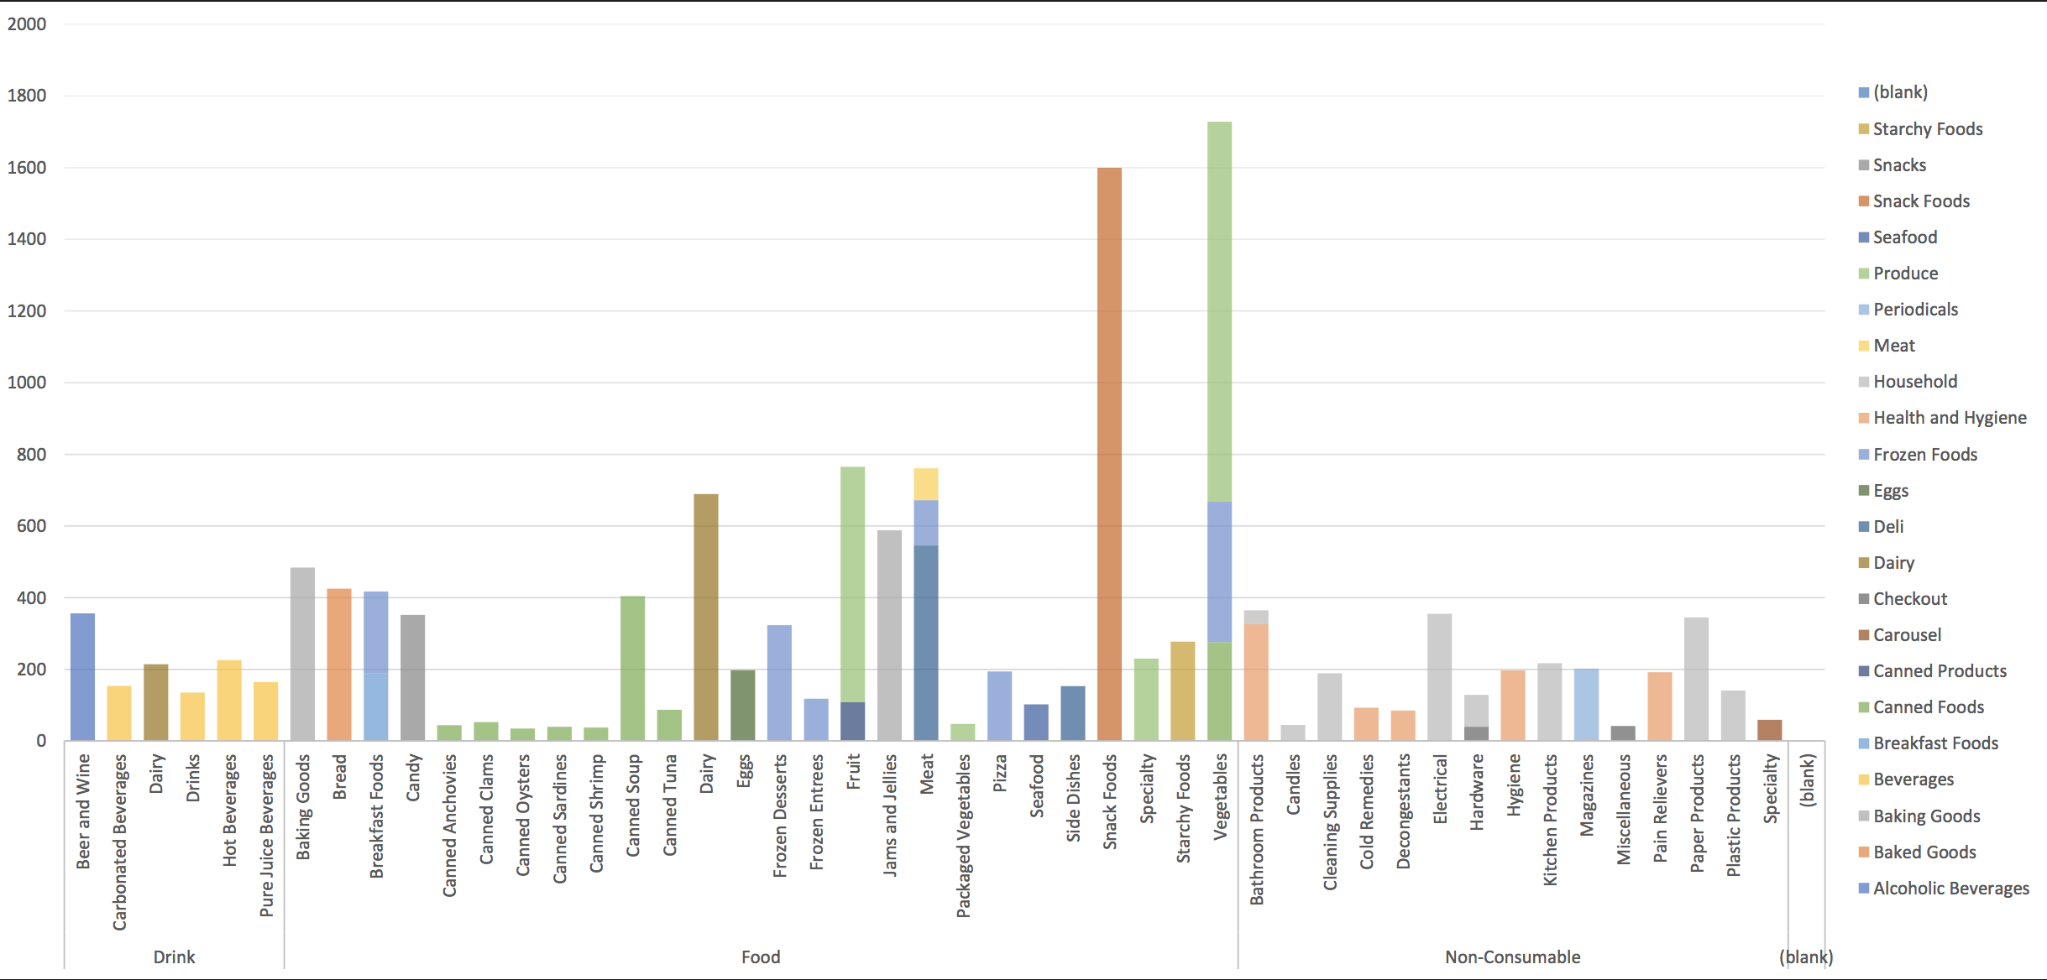
Reduce Product Loss
Product
&
Revenue

Slide 7
Thank You

